Slide 1
Neural network
Binary Classification | Multiclass Classification | Regression
Reshma Jayaprakash
Scifor Technologies Trainee
ID: STB03011

Slide 2
Neural Network Introduction
A neural network is formed when a collection of nodes or neurons are interlinked through synaptic connections
There are three layers in every artificial neural network – input layer, hidden layer, and output layer
The input layer that is formed from a collection of several nodes or neurons receives inputs
Every neuron in the network has a function, and every connection has a weight value associated with it
Inputs then move from the input layer to layer made from a separate set of neurons – the hidden layer
The output layer gives the final outputs

Slide 3
Neural Network Algorithm - Perceptron
It is used as an algorithm or a linear classifier to facilitate supervised learning of binary classifiers
A linear classifier that the perceptron is categorized as a classification algorithm, which relies on a linear predictor function to make predictions
Its predictions are based on a combination that includes weights and feature vector
the perceptron networks were also found to be not capable enough of implementing some basic functions
The perceptron model can only be used to categorize the input vectors’ linearly separable sets. If input vectors are non-linear, they can’t be properly classified
This problem was dealt with as soon as multi-layer perceptron networks and improved learning rules came into the picture

Slide 4
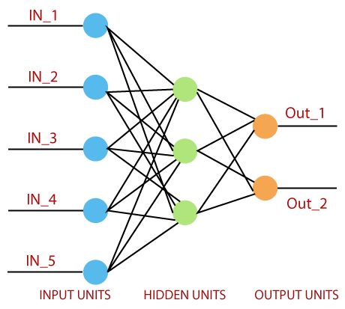
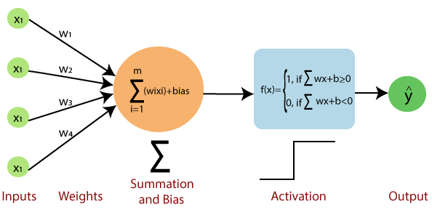

Slide 5
Input value or One input layer:
The input layer of the perceptron is made of artificial input neurons and takes the initial data into the system for further processing.
Weights and Bias:
Weight: It represents the dimension or strength of the connection between units. If the weight to node 1 to node 2 has a higher quantity, then neuron 1 has a more considerable influence on the neuron.
Bias: It is the same as the intercept added in a linear equation. It is an additional parameter which task is to modify the output along with the weighted sum of the input to the other neuron.
Net sum:
It calculates the total sum.
Activation Function:
A neuron can be activated or not, it is determined by an activation function. The activation function calculates a weighted sum and further adding bias with it to give the result.

Slide 6
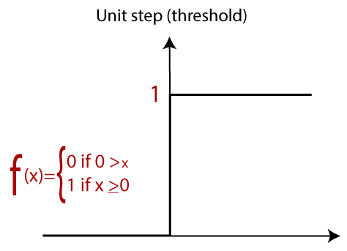
The weights are initialized with the random values at the origination of each training
For each element of the training set, the error is calculated with the difference between the desired output and the actual output. The calculated error is used to adjust the weight
The process is repeated until the fault made on the entire training set is less than the specified limit until the maximum number of iterations has been reached

Slide 7
Types of Perceptron Models
Single-Layer Perceptron Model:
It is one of the simplest Artificial neural network (ANN) types. A single-layered perceptron model includes a feed-forward network and a threshold transfer function within the model. Single-layer perceptron model can only learn linearly separable patterns.
Multi-Layered Perceptron Model:
The multi-layer perceptron model also implements the identical model structure but with more hidden layers. Its alternate name is the Backpropagation algorithm.
Forward Stage: In this stage, activation functions begin from the input layer and terminate on the output layer.
Backward Stage: In this stage, bias and weight values are changed according to the model’s requirement. The error between actual output and demanded output creates backwardness on the output layer and terminates on the input layer.

Slide 8
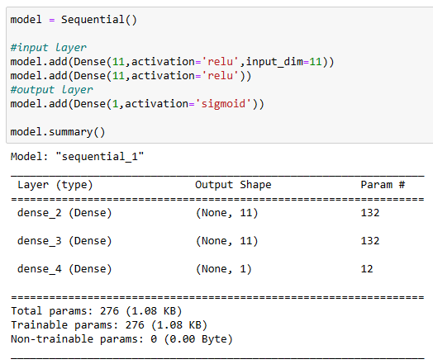
Binary Classification

Slide 9
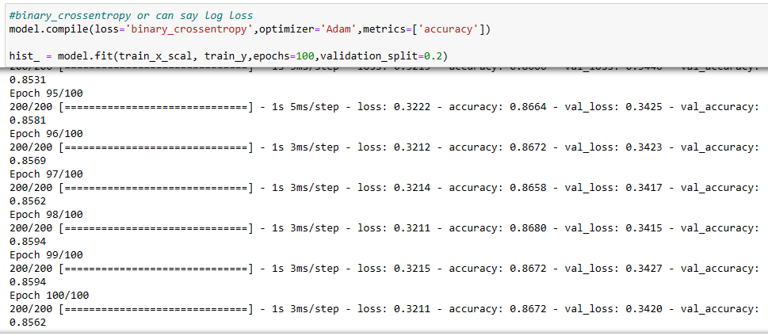

Slide 10
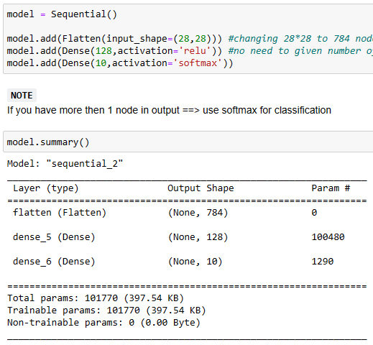
Multiclass Classification

Slide 11
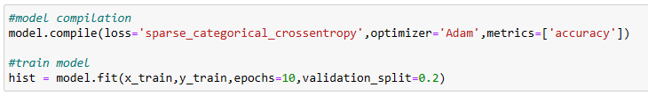
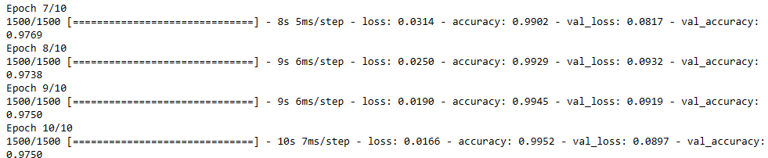

Slide 12
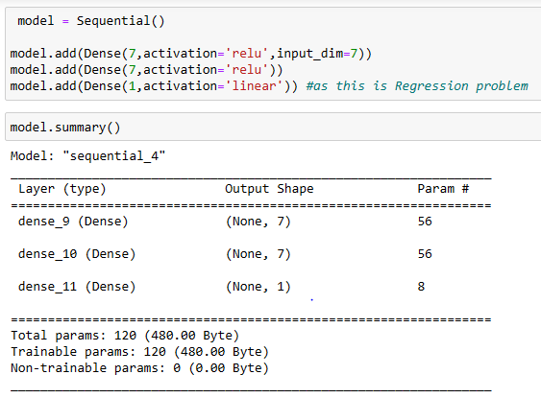
Regression

Slide 13
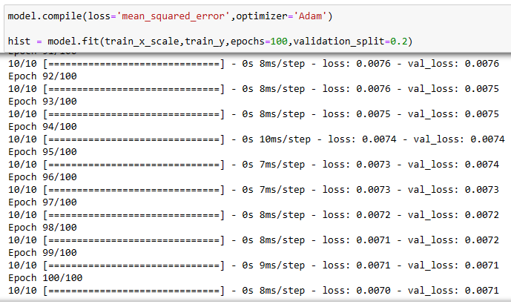
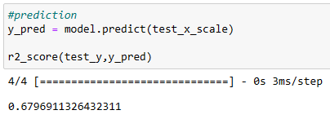

Slide 14
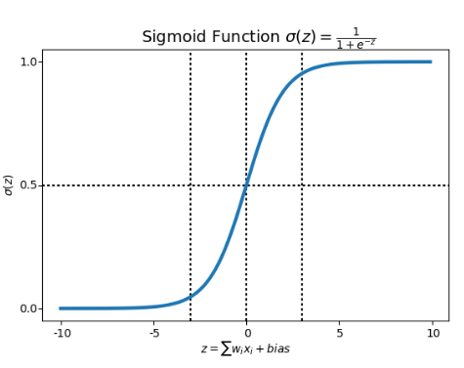
Activation Functions
Sigmoid Activation Function
The sigmoid is a mathematical function that maps input values to a value between 0 and 1, making it useful for binary classification and logistic regression problems. It is commonly used as an activation function in artificial neural networks, particularly in feedforward neural networks.

Slide 15
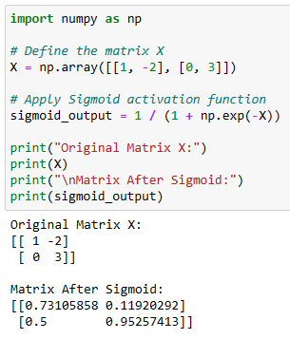

Slide 16
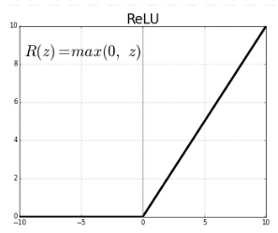
ReLU Activation Function
The rectified linear activation function or ReLU for short is a piecewise linear function that will output the input directly if it is positive, otherwise, it will output zero. It has become the default activation function for many types of neural networks because a model that uses it is easier to train and often achieves better performance.

Slide 17
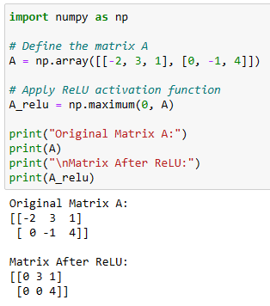

Slide 18
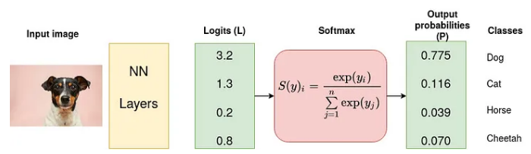
Softmax Activation Function
Softmax is an activation function that scales numbers/logits into probabilities. The output of a Softmax is a vector (say v) with probabilities of each possible outcome. The probabilities in vector v sums to one for all possible outcomes or classes.

Slide 19
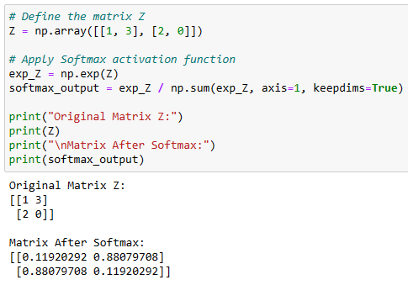

Slide 20
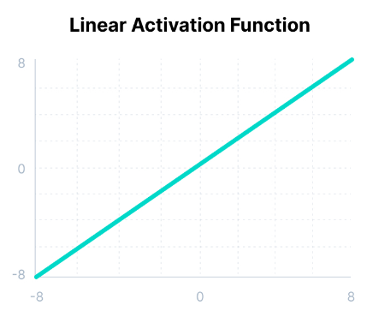
Linear Activation Function
The linear activation function, also known as "no activation," or "identity function" (multiplied x1.0), is where the activation is proportional to the input. The function doesn't do anything to the weighted sum of the input, it simply spits out the value it was given.

Slide 21
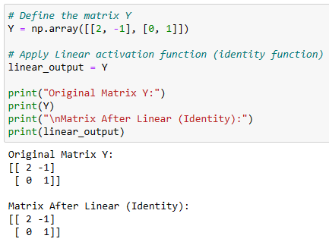

Slide 22
Thank You

